Slide 2
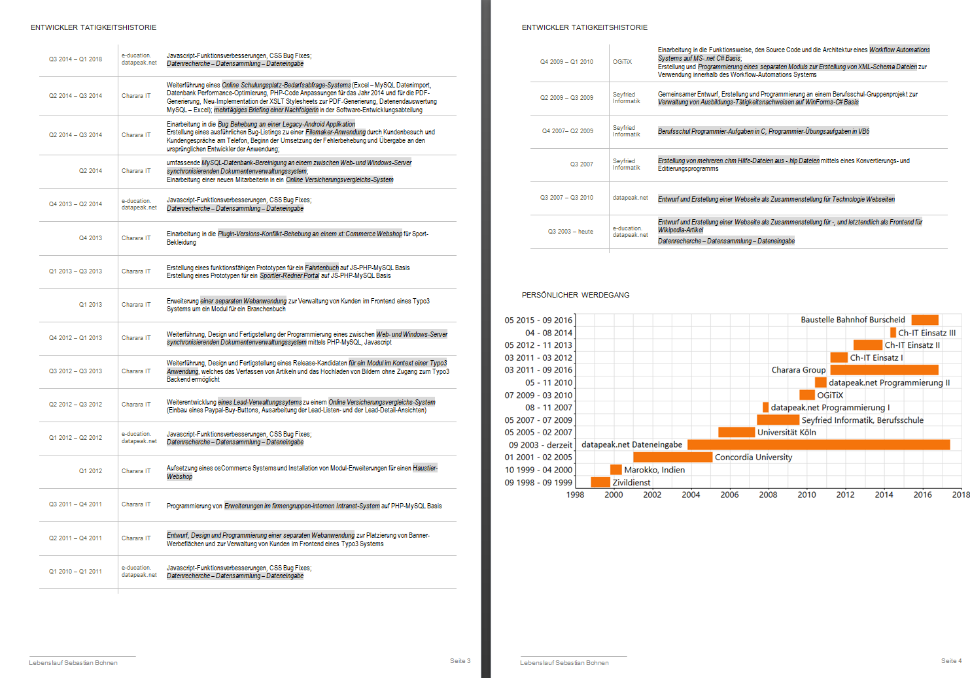

Slide 3
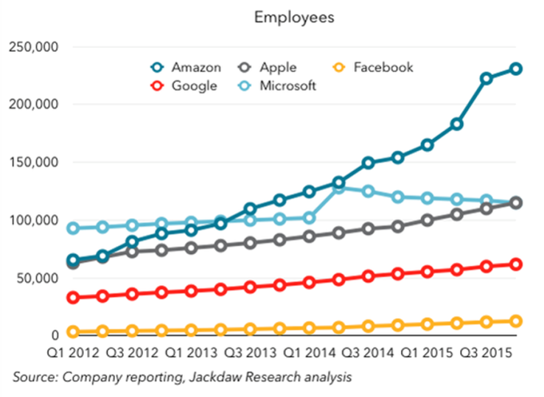
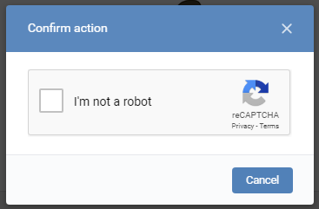
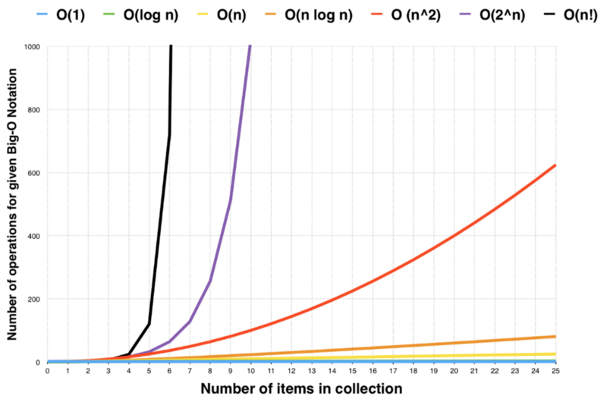
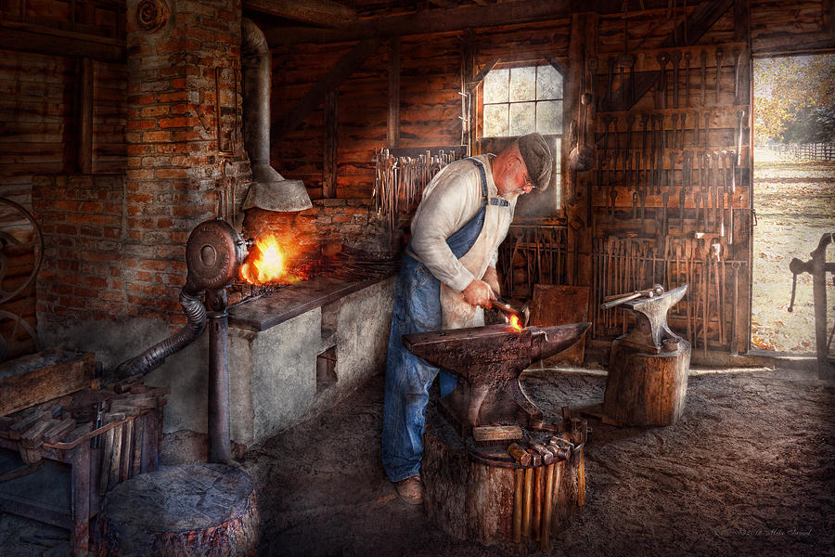
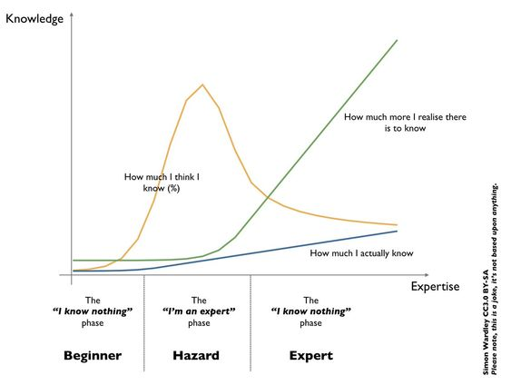

Slide 4
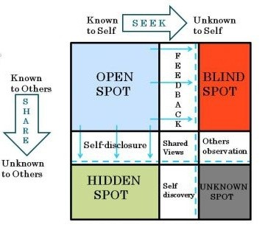
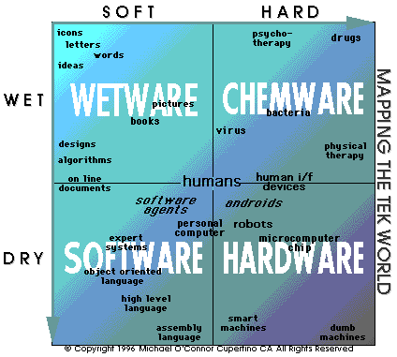
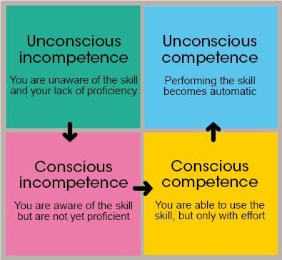

Slide 5
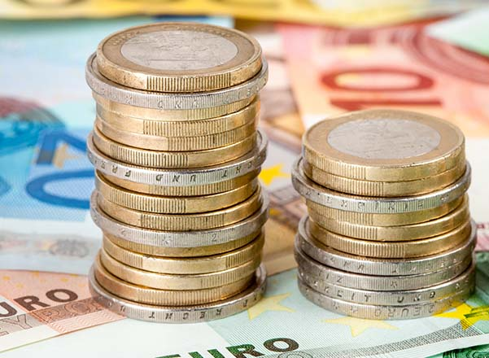
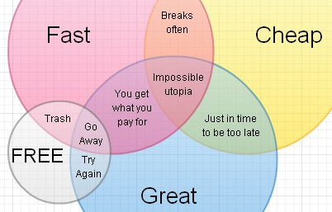
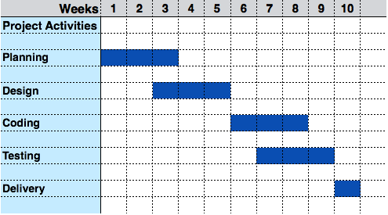
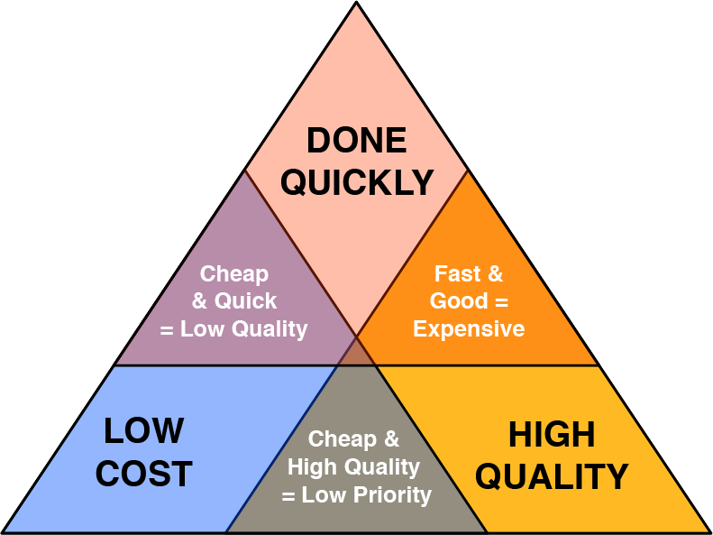
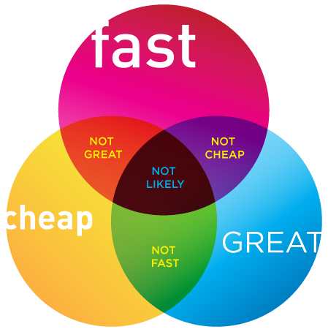
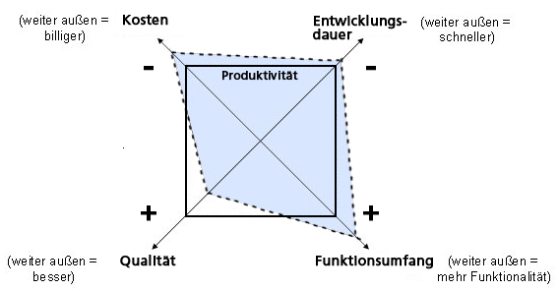

Slide 7
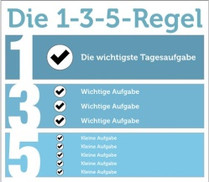
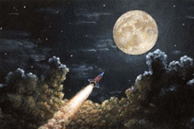
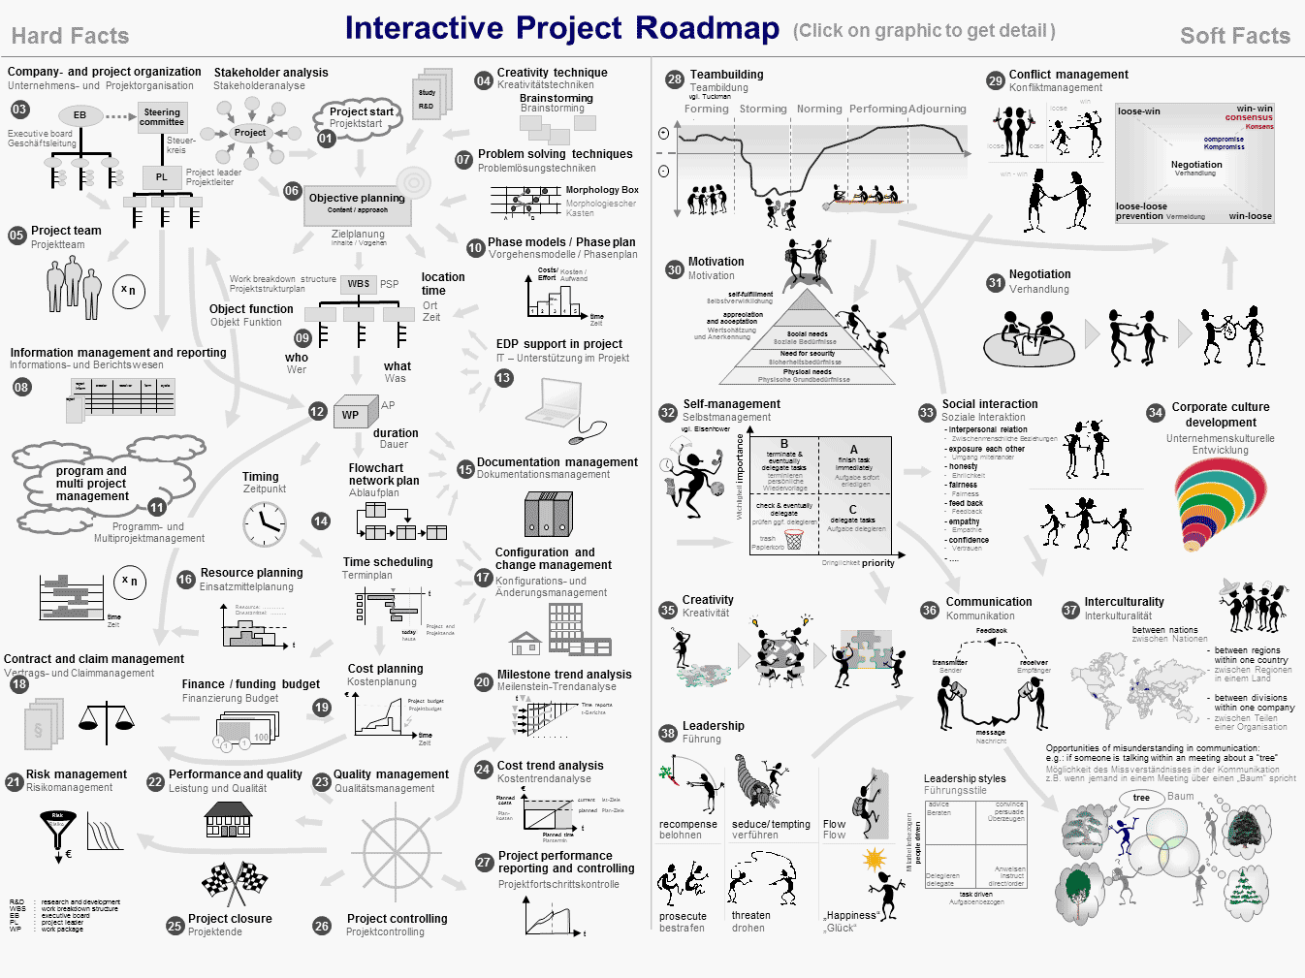
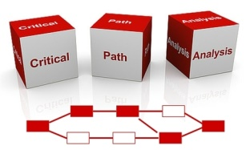
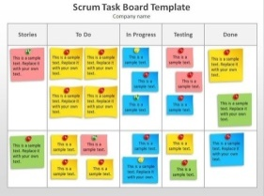

Slide 8
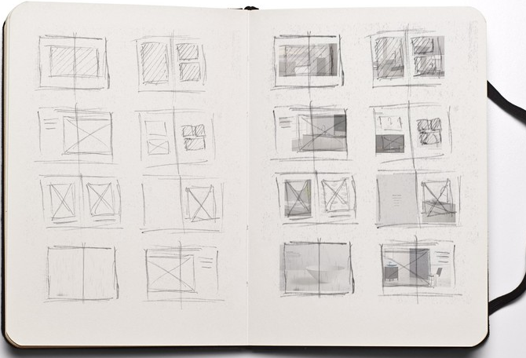
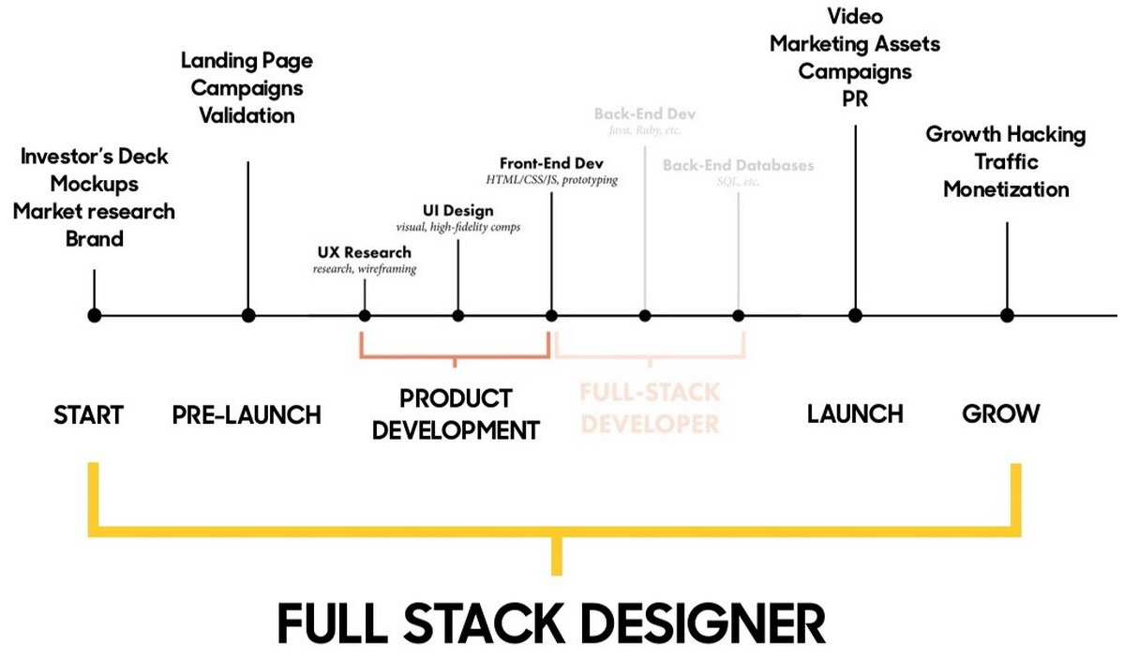

Slide 9
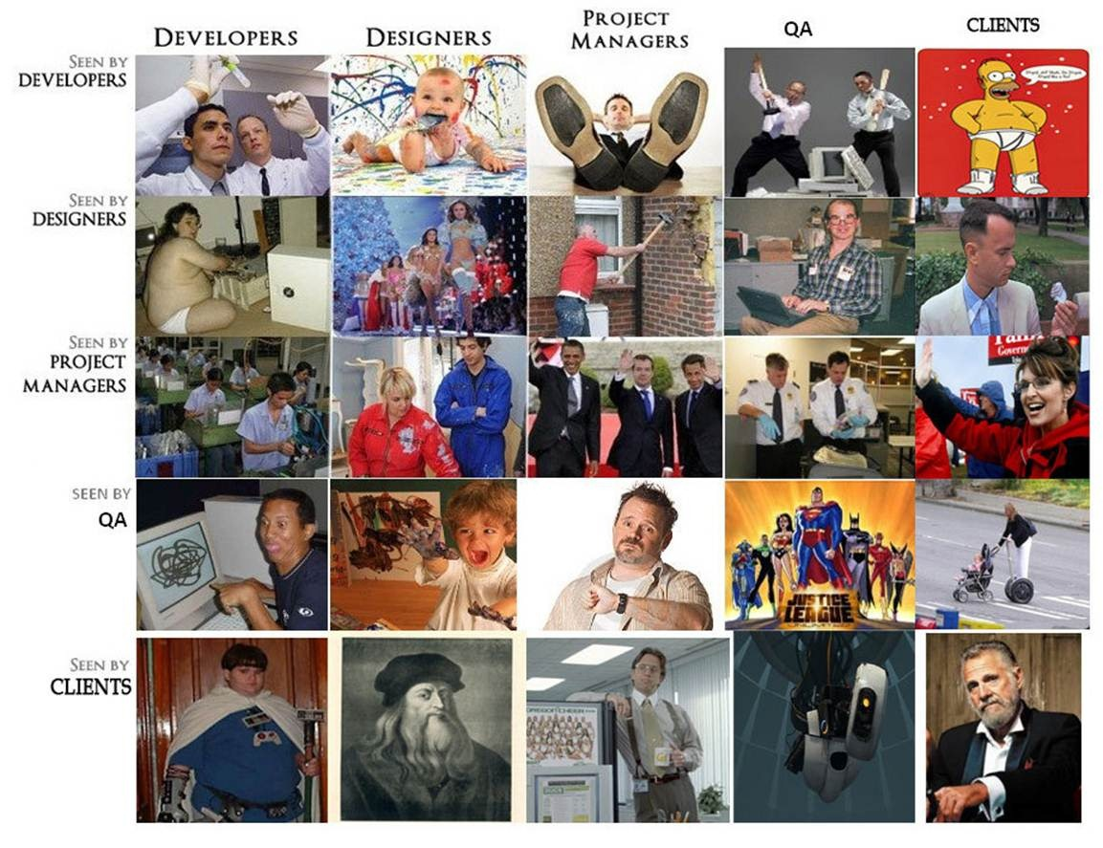
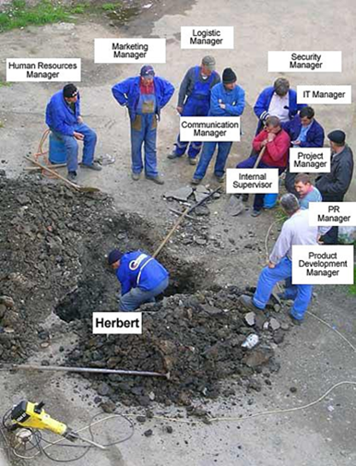
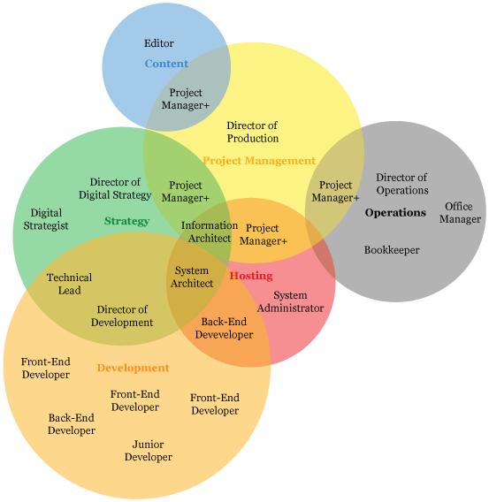
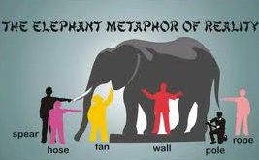

Slide 10
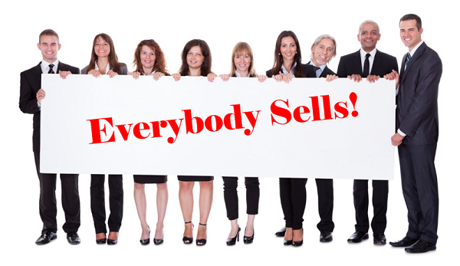
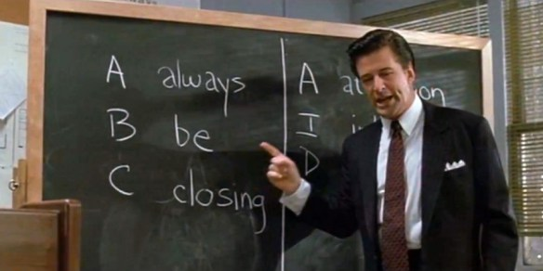
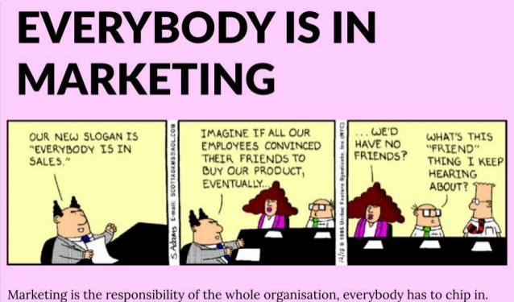

Slide 11
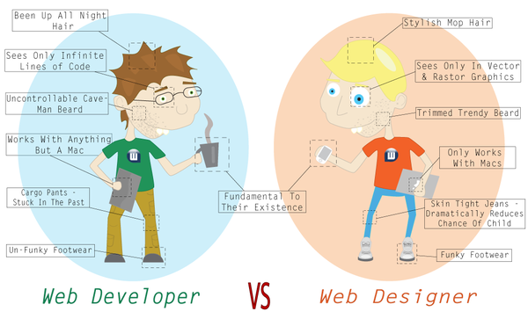
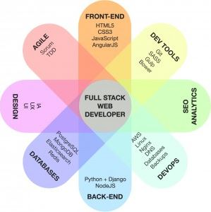
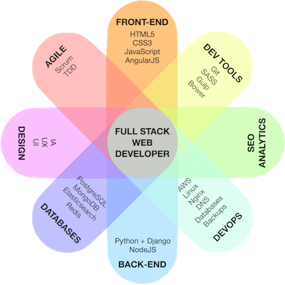
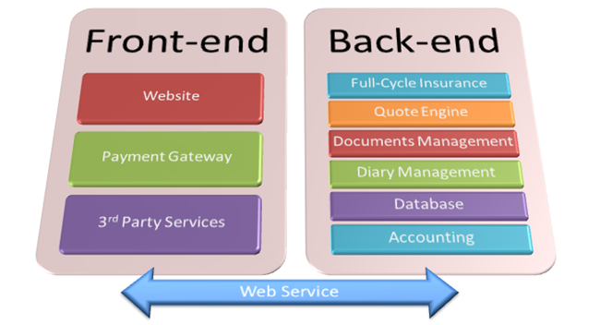

Slide 12
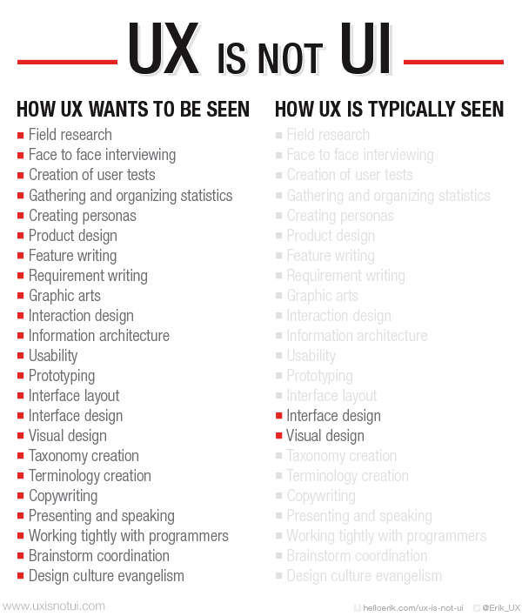
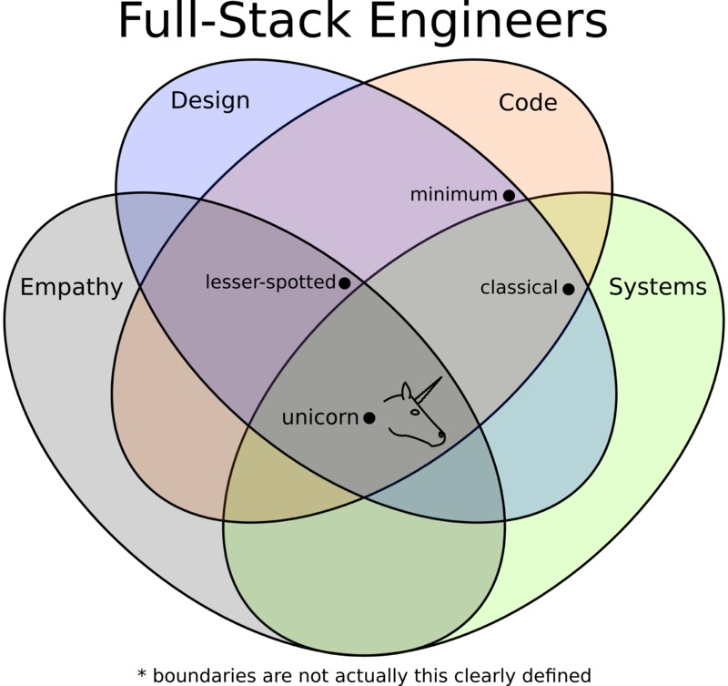
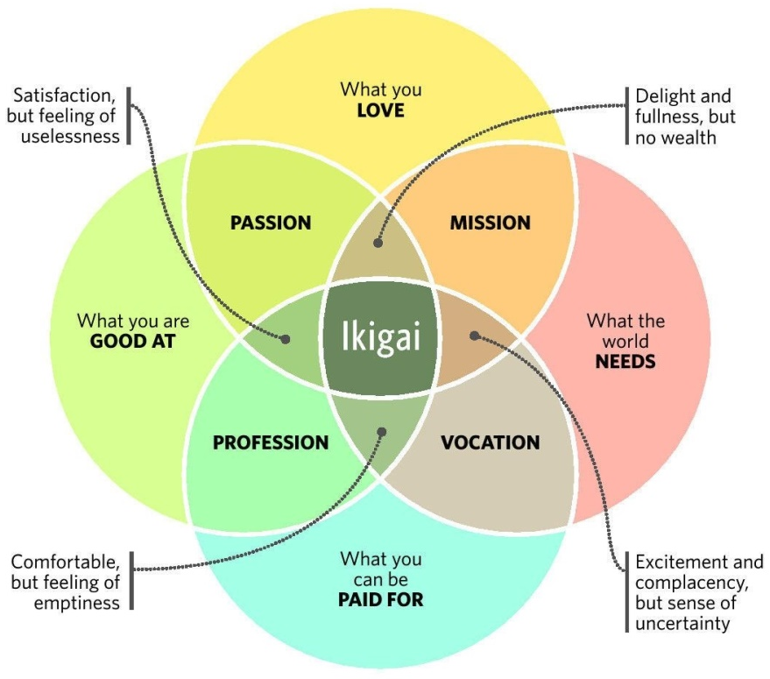
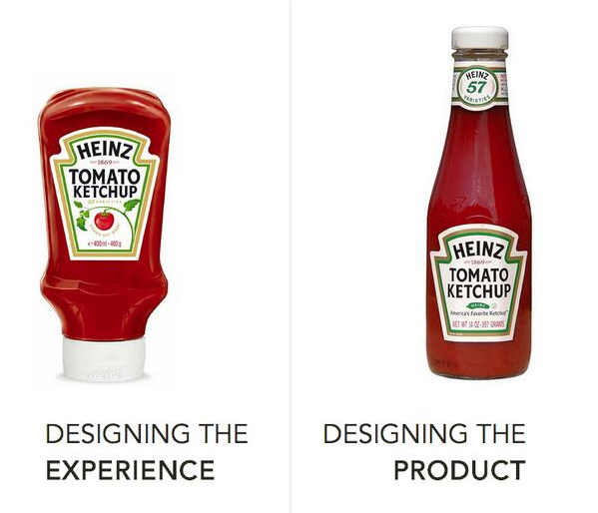

Slide 14
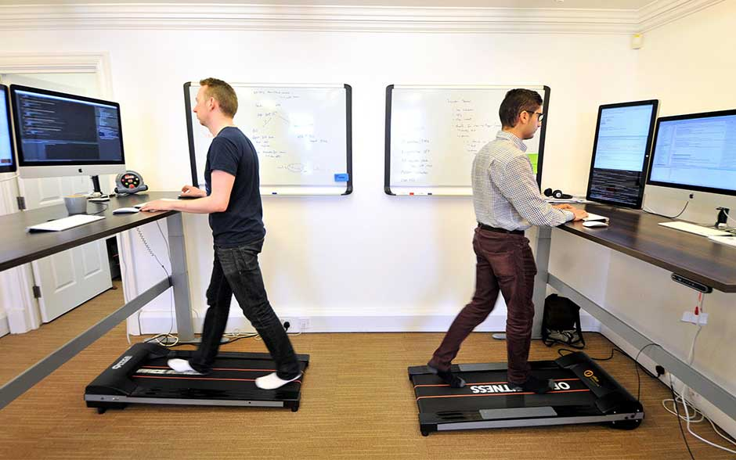
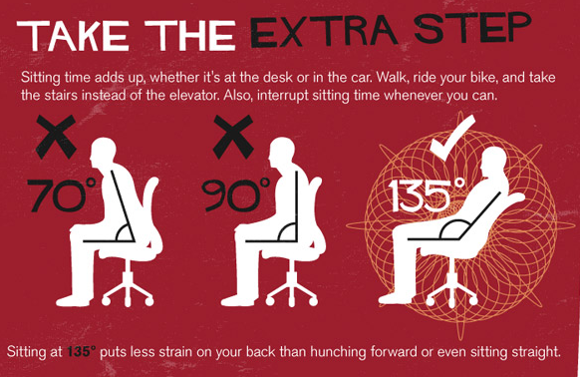
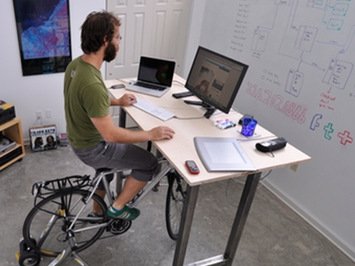
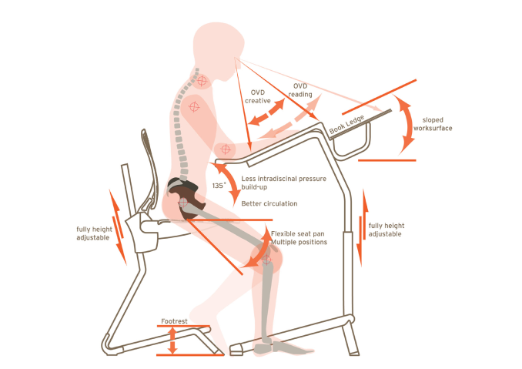
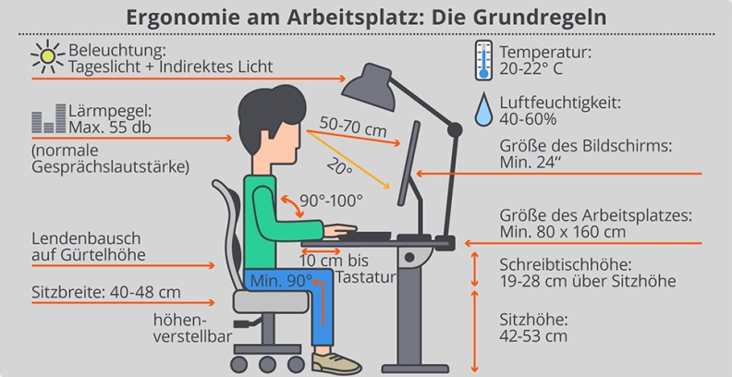
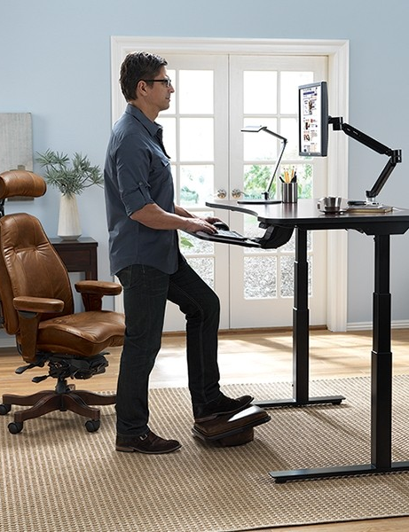

Slide 15
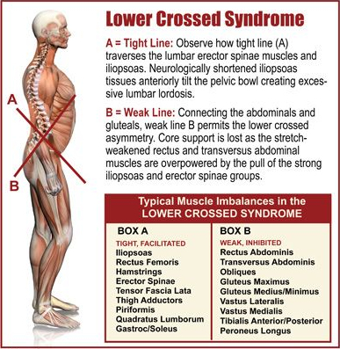
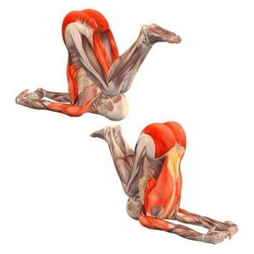
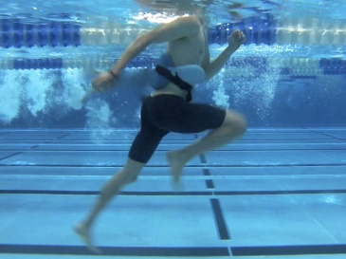
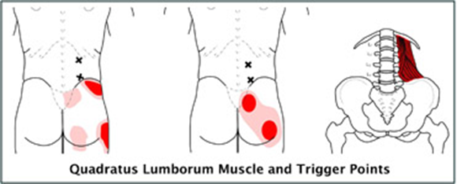
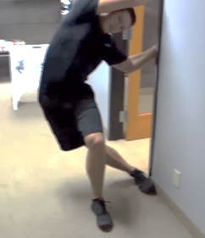
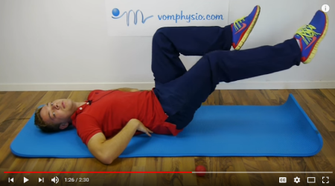

Slide 17
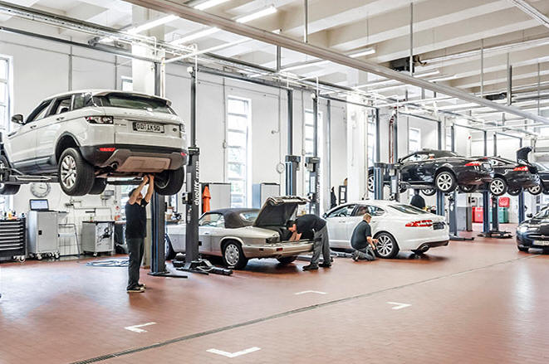

Slide 40
Sebastian Bohnen
Sebastian Bohnen

Slide 49
datapeak.net
e-ducation.datapeak.net
datapeak.net/login/

Slide 51
#1: Plaintext |  | #4: Categorized
#2: Tabular |  | #5: Diagrams
#3: Carousel |  | #6: Hyperlinks

Slide 65
Slide 1
 | http://datapeak.net/Lebenslauf-Sebastian-Bohnen2018.pdf
 | http://datapeak.net/Lebenslauf-Sebastian-Bohnen2018_en.pdf
Slide 3
 | https://realbusiness.co.uk/sales-and-marketing/2017/05/17/building-a-successful-business-by-
 | https://medium.com/coderbyte/a-guide-to-becoming-a-full-stack-developer-in-2017-5c3c08a1600c
 | https://blog.gardeviance.org/2008/04/three-stages-of-expertise.html
Slide 4
 | http://www.1000ventures.com/business_guide/crosscuttings/80-20principle.html
 | http://www.liquidmind.com/fagloss.html
 | http://www.tmsconsulting.com.au/team-building-activities-with-less-pain-and-more-gain-blog/

Slide 66
Slide 5
 | https://www.ezrasf.com/wplog/2011/04/08/pick-two/
 | https://www.linkedin.com/pulse/three-sides-quality-triangle-dead-chris-donaldson
 | https://www.consistec.de/en/solutions/software-development/how-we-develop-software.html
Slide 6
 | http://smarterwebsiteowner.com/how-much-does-a-website-cost-2/
Slide 7
 | https://www.project-roadmap.com/ebook/de/

Slide 67
Slide 8
 | http://www.sinleung.com/blog/
 | https://dribbble.com/shots/2384699-Open-Position-Full-Stack-Designer
 | https://www.slideshare.net/RanSegall/the-full-stack-deisgner-manifesto
Slide 9
 | https://imgur.com/gallery/yciZosW
 | https://www.metaltoad.com/blog/company-organization-chart-you-can-believe
 | https://www.quora.com/What-is-the-rider-and-the-elephant-metaphor
 | https://en.wikipedia.org/wiki/Blind_men_and_an_elephant

Slide 68
Slide 10
 | https://en.wikiquote.org/wiki/Glengarry_Glen_Ross_(film)
 | https://www.amazon.com/Everybody-Works-Sales-Achieve-Success
Slide 11
 | https://www.quora.com/Why-do-people-look-down-front-end-developers
 | http://fredrickroyster.blogspot.com/2014/02/the-difference-between-web-design-and.html
 | https://keepcoding.io/es/blog/lanzamos-el-i-keepcoding-web-developer-master-bootcamp/
 | http://www.onlineinsurancesolutions.co.uk/Insurance-Solutions/Integration/Enterprise-Back-end

Slide 69
Slide 12
 | http://www.helloerik.com/ux-is-not-ui
 | https://medium.com/@aryanindraksh/5-great-analogies-to-highlight-the-difference-between-ux-ui
 | http://daemon.co.za/2014/04/what-does-full-stack-mean
 | https://www.thestar.com/life/relationships/2016/09/06/why-north-americans-should-consider
Slide 13
 | https://www.careeraddict.com/top-10-websites-to-find-freelance-work

Slide 70
Slide 14
 | http://projectiondesk.com/manual-treadmill-under-desk-wonderful/
 | https://www.relaxtheback.com/adaptdesk-by-relax-the-back.html
 | http://www.agreatoffice.net/find-a-great-chair-with-the-best-kneeling-chair-reviews/
 | https://www.wired.com/2011/10/kickstand-desk-lets-you-ride-your-bike-at-work/
 | https://ergonomie-am-arbeitsplatz.de/
Slide 15
 | https://erikdalton.com
 | https://www.beachbodyondemand.com/blog/plank-exercises-for-abs
 | Quadratus Lumborum Stretch
Slide 16
 | https://www.wspa.com/entertainment/your-carolina/floss-dance-challenge/1199235784

Slide 71
Slide 18
 | https://en.wikipedia.org/wiki/Anna_Karenina
 | https://en.wikipedia.org/wiki/Guns,_Germs,_and_Steel#Agriculture
 | https://www.slideshare.net/acruise1/devops-days-2014-preso
Slide 19
 | http://fortune.com/2014/09/04/peter-thiels-contrarian-strategy/
 | http://www.dansilvestre.com/zero-one-peter-thiel/
Slide 20
 | https://getbambu.com/blog/what-is-employee-advocacy/
 | http://www.hopliteia.com/

Slide 72
Slide 21
 | https://toggl.com/blog/seven-levels-developer-hell/
 | https://uxmag.com/articles/cognition-the-intrinsic-user-experience
Slide 22
 | https://personal-development.com/chuck/our-expectations-self-fulfilling.htm
 | https://en.wikipedia.org/wiki/Office_Space
 | https://en.wikipedia.org/wiki/Broken_windows_theory
 | https://jansoehlke.com/2014/09/made-sweden/
Slide 23
 | https://oliveremberton.com/2014/how-to-find-your-passion/
 | https://richtopia.com/inspirational-people/peter-polydor-startup-goal-setting-recommendations

Slide 73
Slide 24
 | https://www.reddit.com/r/explainlikeimfive/
 | https://blochoestergaard.dk/how-to-stay-relevant-in-a-constantly-changing-world/
 | https://www.slideshare.net/amyjokim/gamification-101-short-talk/
 | https://mathias-sager.com/2017/11/01/history-and-philosophy-of-learning-theory/
 | https://www.slideshare.net/mbponkiya/sports-psychology-motivation
 | https://medium.com/@Ekta_Sengar/lets-do-it-tomorrow-e00c67bf33be
Slide 25
 | https://www.omundodelua.com/agile-vs-scrum-vs-waterfall/

Slide 74
Slide 26
 | https://www.statista.com/chart/11690/the-top-reasons-startups-fail/
 | https://www.slideshare.net/MBA-ASAP/top-20-reasons-why-startups-fail
 | https://www.zoe-online.org/zeitschrift/rubriken/einblick-grafiken/einblick-ausgabe-109/
Slide 27
 | https://seths.blog/
 | https://www.entrepreneur.com/article/227850
 | https://www.slideshare.net/gchinar/steve-jobs-iphone-launch-2007
 | https://oliveremberton.com/2014/the-problem-isnt-that-life-is-unfair-its-your-broken-idea

Slide 75
Slide 28
 | https://www.slideshare.net/gaylecurtis/structured-ideation-and-design-thinking
 | https://www.zentao.pm/share/treeswingpm-97.html
Slide 31
 | https://oliveremberton.com/2014/if-you-want-to-follow-your-dreams-you-have-to-say-no-to-all
 | http://malcolmocean.com/2013/06/flow-vs-deliberate-practice/
 | https://alessandroinnocenti.wordpress.com/
 | https://spinsucks.com/communication/cognitive-bias-communications-plan/
 | http://goboiano.com/japan-shares-how-being-an-otaku-is-different-from-the-past/

Slide 76
Slide 32
 | https://www.thedailybeast.com/inside-donda-kanye-wests-plan-to-rule-the-world
Slide 35
 | https://guykawasaki.com/the-only-10-slides-you-need-in-your-pitch/
 | https://medium.com/the-corporate-startup/a-new-typology-for-innovation-that-combines
Slide 41
 | https://sommerhoff.de/ueber-sommerhoff/stufenfortbildung
 | https://www.fachinformatiker.de/topic/156663-karriere-nach-der-umschulungausbildung/

Slide 77
Slide 42
 | http://www.hit-karlsruhe.de/hit-mic/projekte/WS12_Hoehenmessung/verfahrensmatrix.html
 | http://www.ial.de/portal/
Slide 43
 | http://www.sae.edu/deu/de

Slide 78
Slide 44
 | https://www.eclipse.org/pdt/
 | https://answers.microsoft.com/en-us/office/forum/officeversion_other-office_other/
 | https://www.vandyke.com/products/securecrt/
Slide 45
 | https://www.slideshare.net/acruise1/devops-days-2014-preso
 | https://www.yegor256.com/2016/08/15/what-is-wrong-object-oriented-programming.html
Slide 46
 | https://www.sitecrafting.com/top-5-php-template-engines/
 | https://dzone.com/articles/its-high-time-to-say-goodbye-to-the-lamp-stack-and

Slide 79
Slide 47
 | https://uxdesign.cc/artificial-intelligence-and-the-disappearance-of-non-natural-interfaces
 | http://www.oracle.com/technetwork/articles/soa/weir-3rd-gen-api-mgmt-3787102.html
Slide 48
 | https://www.slideshare.net/fabpot/the-symfony-platform-create-your-very-own-framework-php
 | https://www.quora.com/Which-is-the-best-framework-for-PHP
 | https://belitsoft.com/laravel-development-services/cms-or-framework-wordpress-or-laravel
Slide 49
 | http://e-ducation.datapeak.net/details.php
 | https://wiki.dbpedia.org
 | https://www.wikipedia.org

Slide 80
Slide 57
 | http://m.facebook.com
 | https://www.humhub.org/de
Slide 54
 | https://medium.com/@johnharrydsouza/based-learning-7-gbl-game-based-learning-123c2a5a5b55
 | http://blog.kennethjhong.com/2012/08/whats-big-deal-about-bartles-player.html
 | https://www.slideshare.net/CharlesCotter/employee-engagementbest-practice-principles
Slide 61
 | https://medium.com/basic-income/cutting-the-gordian-knot-of-technological-unemployment
 | https://medium.com/basic-income/ubi-is-a-moral-choice-before-anything-else-40300f9b75de
 | https://kagbig.wordpress.com/2017/09/20/wont-people-stop-working/

Slide 81
Slide 62
 | https://en.unesco.org/sdgs
Slide 63
 | https://de.wikipedia.org/wiki/Mammon#/media/File:Mammon_and_His_Slave.jpg
 | https://firehead.net/2018/03/information-4-0-techcomm-primer/
Slide 64
 | http://thehungergames.wikia.com/wiki/Prep_team

